Slide 1
Javascript
its natural habitat the browser
Notes:
Welcome back
last session why Javascript natural application programming language
my last argument is that only one running on all browsers
in this talk introduce the idea of the web platform, bit of history, what that is and why it matters
also address some elephants in the room
2 mins (2)

Slide 2







Notes:
java applet
ActiveX
shockwave
flash
Quicktime
Silverlight
why all fail?
proximate causes – Steve Jobs not liking them etc.
ultimate cause:
all plugins to the browser
downloaded, security, sandboxes
2 mins (4)

Slide 3

Notes:
the all conquering browser
browser has all of this (cheekily)
where it does not – being built in
it’s all about the browser
1 min (5)

Slide 4
The Web Platform
~
The Browser
Notes:
‘html 5’, ‘web 2.0’ etc – I prefer ‘web platform’
technologies to leverage what the browser has…
what the browser gives you and how to use that
1 min (6)

Slide 5
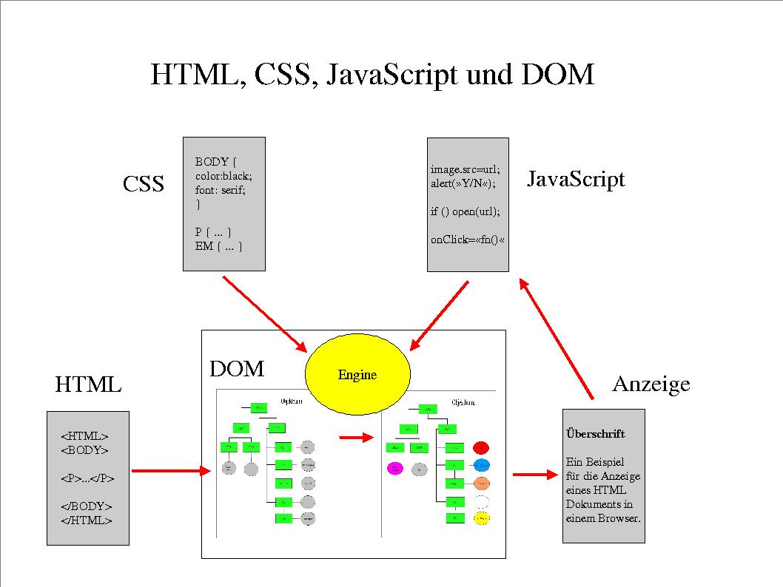
http://krum.rz.uni-mannheim.de/pk1-2002w/sess-5.html
Notes:
so what does the browser do?
from 2002! pretty much what you need until last few years
DOM important so next slide
first part 1991 Tim Berners-Lee file HTML > DOM
CSS
Javascript – here in its original planned usage
so for many years trilogy provided for a:
presentation device, limited interactivity
javascript lived up to, and no further, than its original intent – as a ‘glue’ language
4 mins (10)

Slide 6
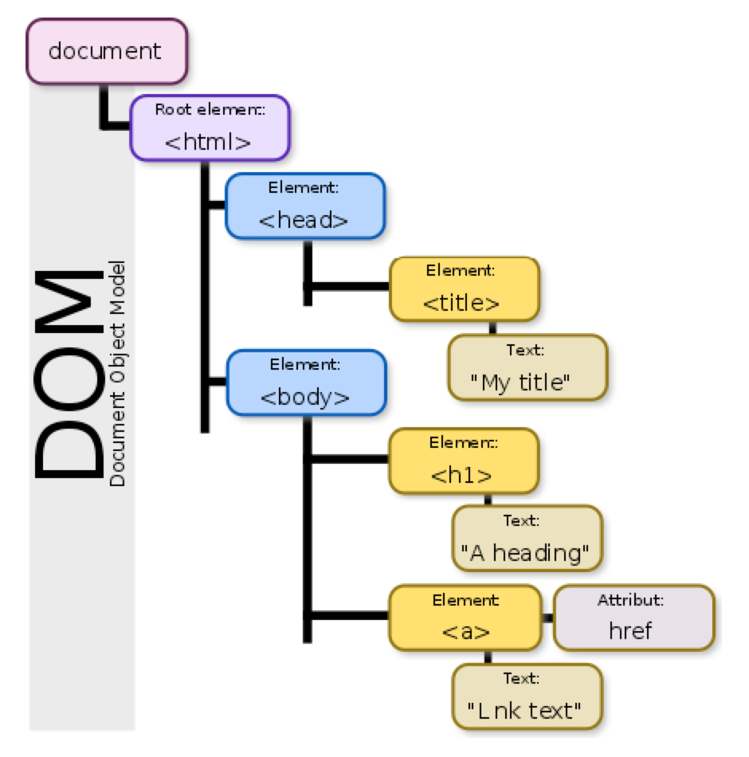
https://css-tricks.com/dom/
https://en.wikipedia.org/wiki/Document_Object_Model
Notes:
tree
representation html > DOM > screen
excellent link

Slide 7
http://www.evolutionoftheweb.com/
Notes:
2 big things changed - AJAX and competition returning
let me show cool graphic
1995 – 2004 bugger all innovation on client because of browser wars
where there was innovation was on server as different ways of generating files TBL-like for client
PHP > Java/JSP > ASP
however MS did one thing right:
spot that green line
3 mins (13)

Slide 8
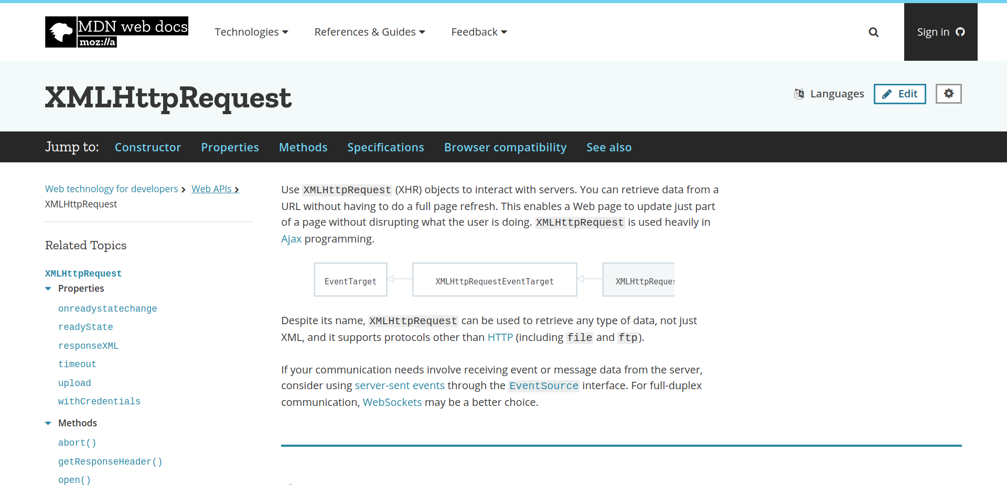
https://developer.mozilla.org/en-US/docs/Web/API/XMLHttpRequest
Notes:
what emerged was this guy – badly named
initially IE
standardise around 2004
so Jesse James Garret came up with ‘AJAX’
crucial: async calls with ability to mutate DOM
don’t need server to create pages for you
‘single page application’
good thing?
scalability / performance / interaction – start, start to compare with native apps
stopped being presentation and became interactive
session 5 – scary walking skeleton
4 mins (17)

Slide 9
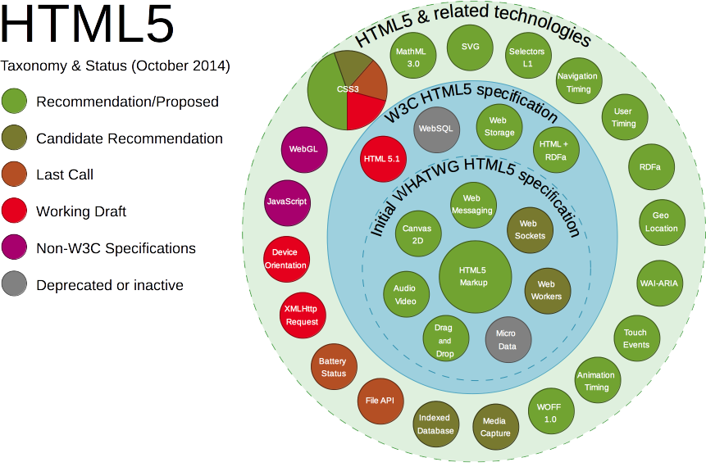
https://platform.html5.org/
https://en.wikipedia.org/wiki/HTML5
Notes:
second big thing – back to chart – competition
what browsers can do – more & more
accessed either through html or JS
see client-side version of application/system division
from link point out
notifications
geolocation / battery / clipboard
offline / service workers
note: relevant to later discussions
3 mins (20)

Slide 10
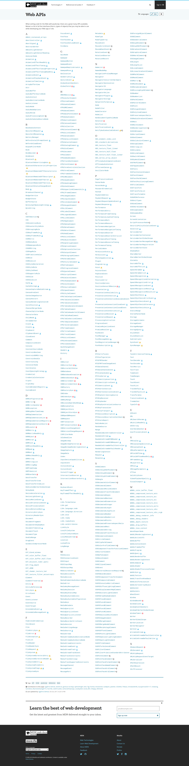
The Web Platform
Javascript
CSS
+
DOM
HTML
HTTP
https://developer.mozilla.org/en-US/docs/Web/API
Notes:
so core technologies
HTTP (HTTP2)
1 mins (21)

Slide 11

diversity
performance
security
responsive
how to write SPA’s
platform limits
Notes:
so browser is becoming all-singing all dancing
what are pain points?
1 min (22)

Slide 12







Notes:
browser diversity
Safari – way behind as development tool
MS – never forgive them
Amazon silk
UC browser
konqueror
of course others
1 mins (23)

Slide 13
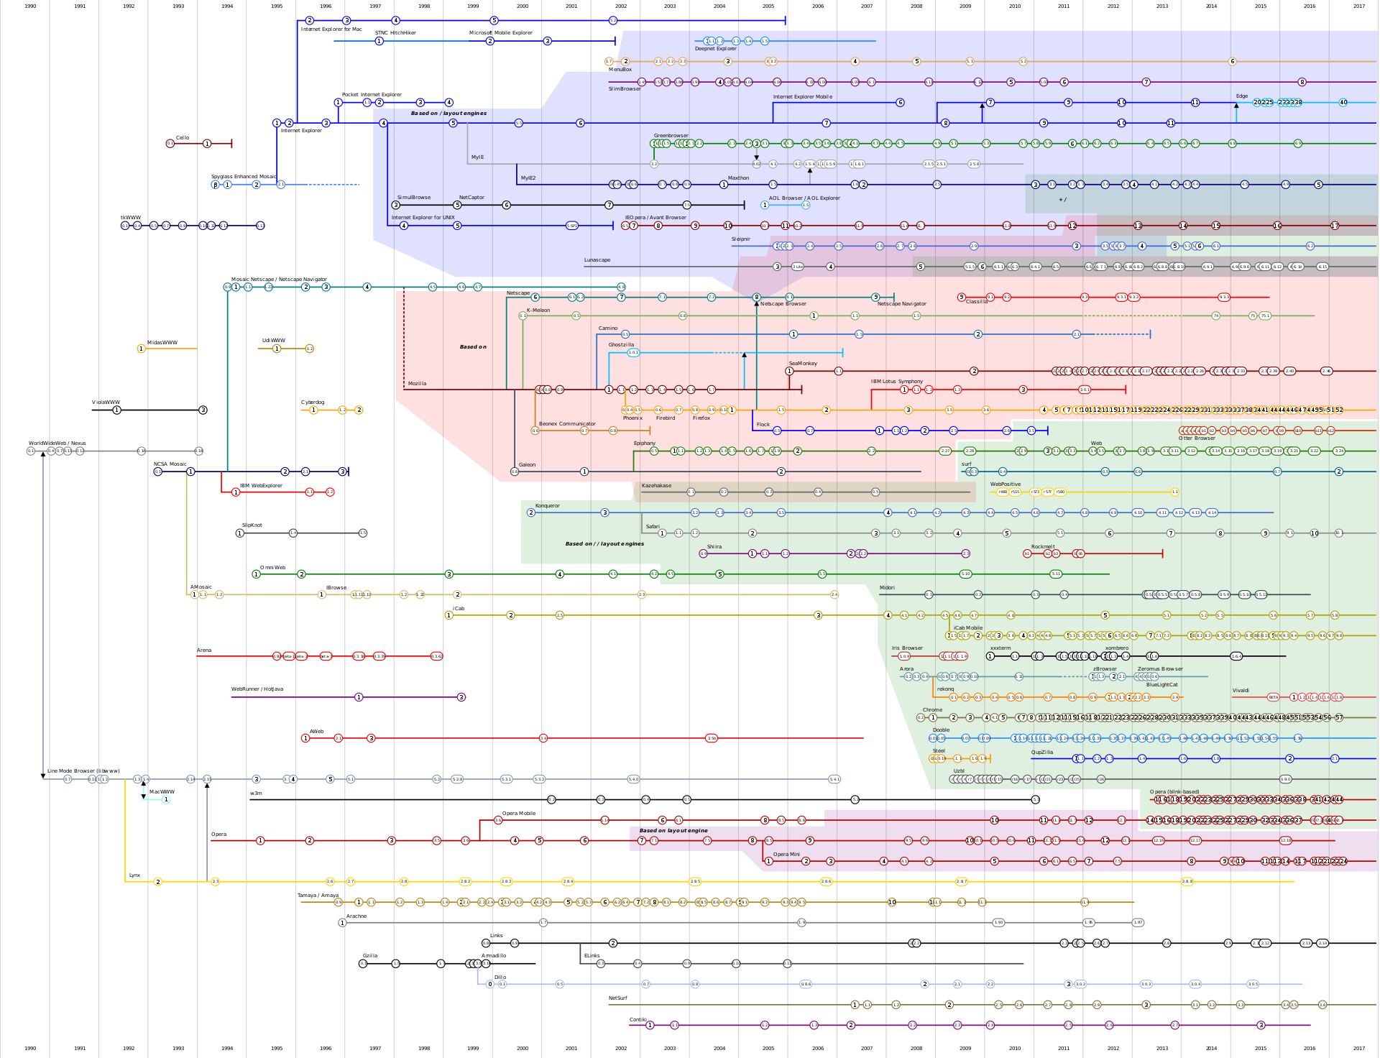
https://en.wikipedia.org/wiki/List_of_web_browsers
Notes:
how deal? after all, have always had ‘standards’
bad old days ‘optimised for IE’
first thing to say that diversity misleading – fewer engines
technical fixes
various libraries offer a common API – Jquery
polyfills – built into build tools (session 6)
procedural
standards = even MS obey now + well understood and accepted approvals process
which allows for canIUse – figure / geolocation
4 mins (27)

Slide 14
The Web Platform
Javascript
CSS
+
DOM
HTML
HTTP
https://developer.mozilla.org/en-US/docs/Web/API
Notes:
Performance
moving mobile meant reversing performance gains of past decade; much IO bound
all about perceived performance
truly need to understand ‘web platform’ to combine technologies
look at each layer
HTTP: understanding protocol ‘TCP slow start’, browser usage
HTML: controlling HTTP + headers
DOM: minimising manipulation (later - React)
CSS: using hardware
Javascript: understand event loop - loupe demo
Speed demo (explain via bbc)
5 mins (32 mins)

Slide 15
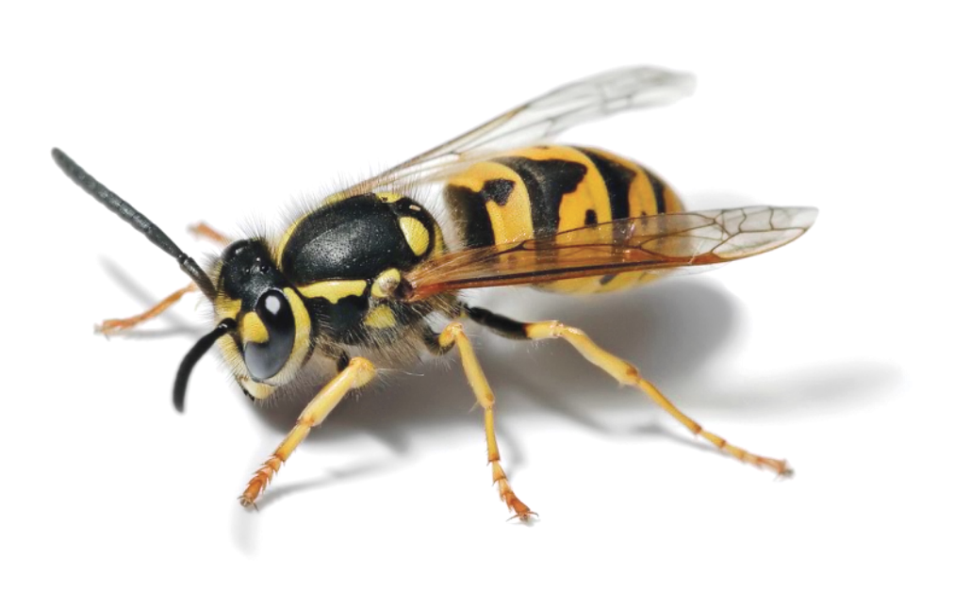
https://www.owasp.org/
Notes:
Security
web platform is inherently insecure
best make it very, very difficult and/or cost-ineffective
how? like browser diversity: awareness, public discourse, process
security by obscurity dead except in minds of politicians
follow guidelines, proactively test, proactive tooling – node security platform
owasp demo (top 10)
crucial dev & devops coordination
the result…
3 mins (35)

Slide 16
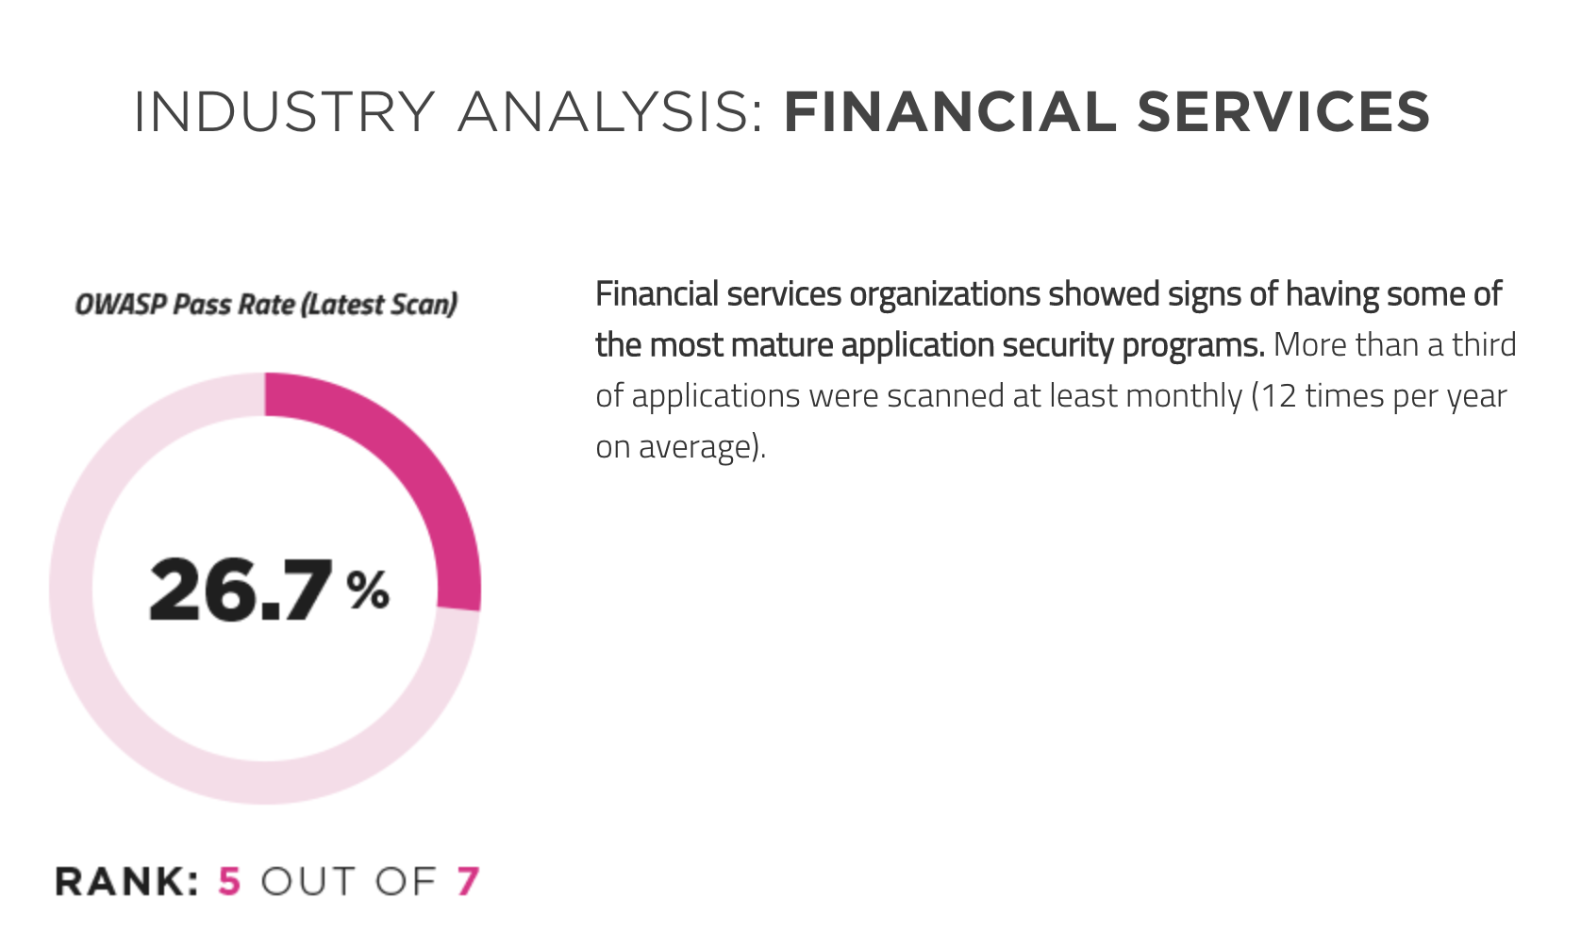
https://www.veracode.com/state-of-software-security-report
Notes:
Tesco Bank does much better, I’m sure
1 min (36)

Slide 17

https://medium.com/designing-medium/regular-and-compact-ios-display-size-breakdown-for-designers-d3ff3044e06e
Notes:
Onto happier story – responsive
browser all about putting things on a screen, lots of screens to consider
In past mobile sites
2015 iPad / iPhone range
UX design challenge has not gone away
But techy problems pretty well solved
2 issues – layouts, dimensions, working out size in first place
Layouts – CSS conceptually and syntactically difficult, now Flexbox / CSS Grid
dimensions – px, em’s, vh
Andy in audience – horror in surface.css
media queries @media
2 mins (38)

Slide 18
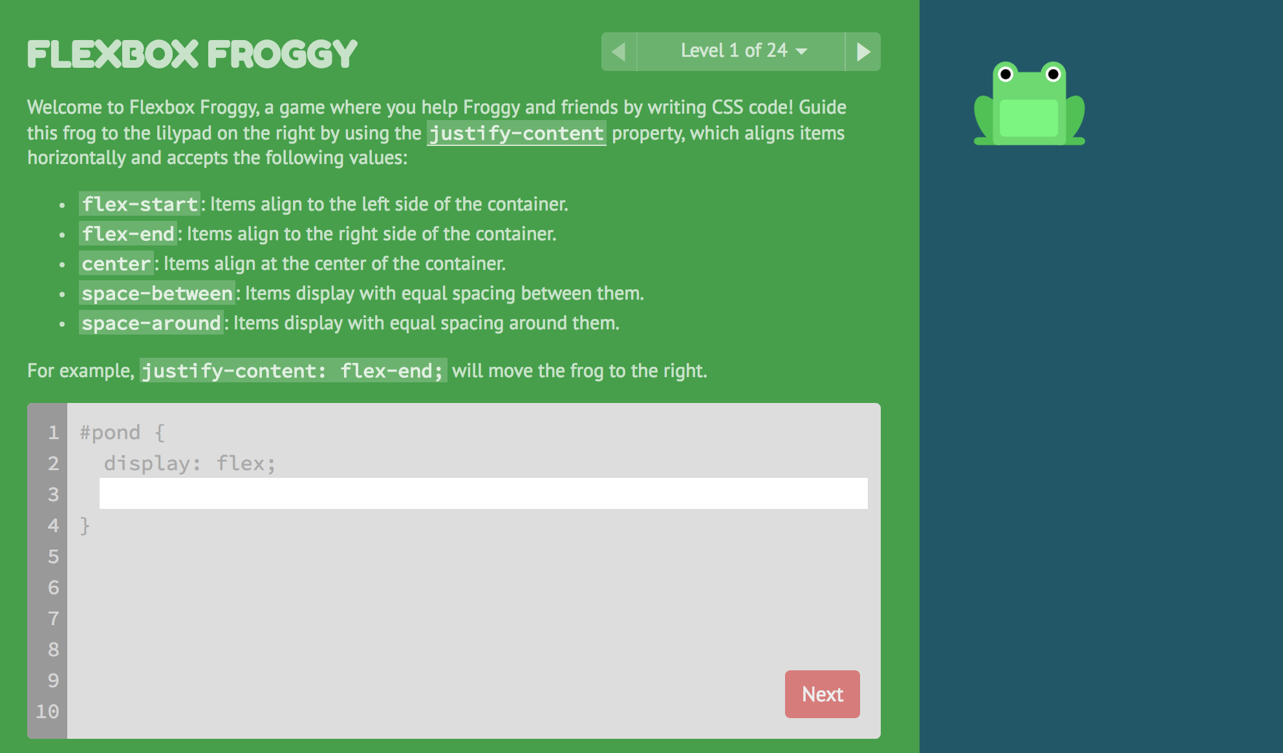
http://flexboxfroggy.com/
Notes:
shout out that even CSS can be fun!
1 min (39)

Slide 19
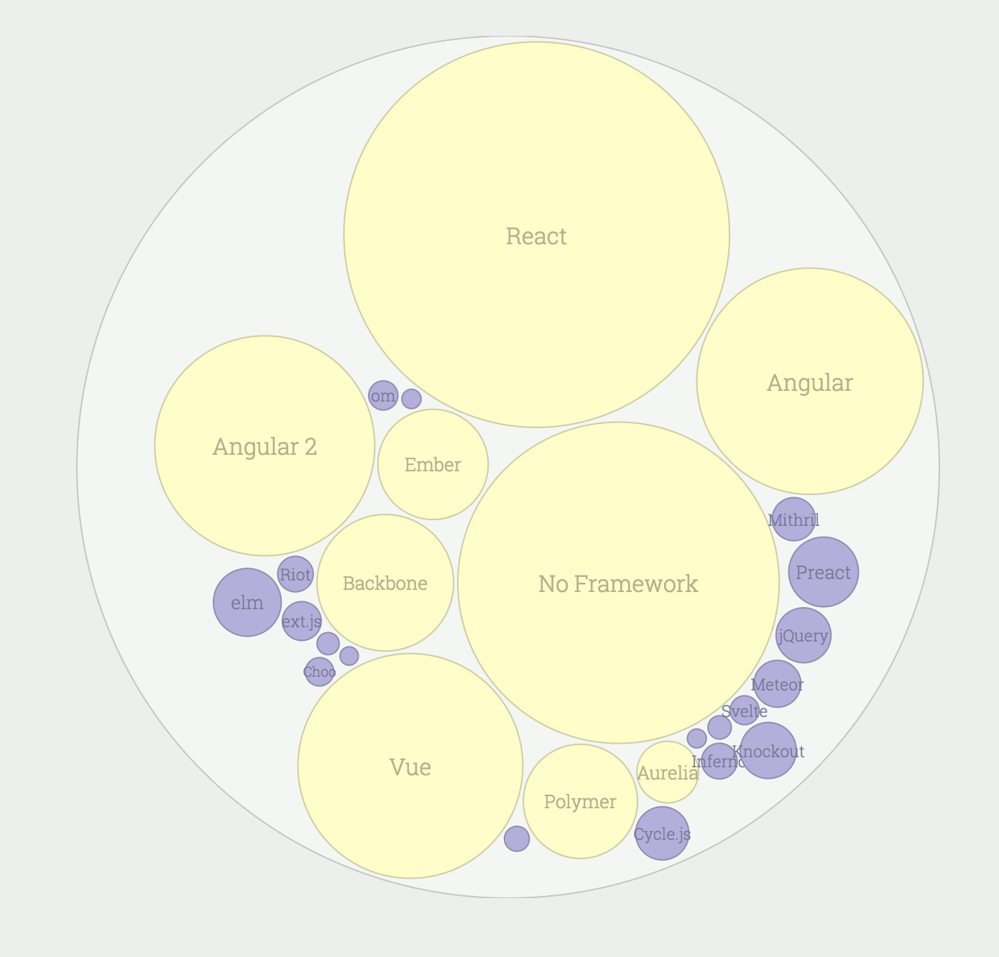
https://stateofjs.com/2017/front-end/other/
Notes:
how to write web applications
when XHR came in, suddenly moved off snippets of code and full applications
initially moved server patterns onto client
or combined server/client frameworks
move to libraries (run libraries in your code, not your code in libraries)
React – heard a lot – focus only on generating UI
tore up a lot of shibboleths
separation of concerns != separation of technologies
cohesion and coupling
session 5 – explanation
3 mins (42)

Slide 20
The Web Platform
Javascript
CSS
+
DOM
HTML
HTTP
https://developer.mozilla.org/en-US/docs/Web/API
Notes:
Platform
restrictions
e.g. Surface vs porn sites (allegedly)
1 min (43)

Slide 21
2,924,255 online banking
6,687,908 mobile app
logins last month
Notes:
so gone into briefly, why JS won the web, the challenges today, and how they are being met
now wish to switch tack
what are these 2 numbers?
2 mins (45)

Slide 22



Notes:
2 elephants
development is not js
winning on web – a pyrrhic victory?
undermine my whole notion that JS will be 1 of 2 languages?
I say No, and perhaps more interestingly how JS relates to the smart phone world
so first, some bold statements
1 min (46)

Slide 23
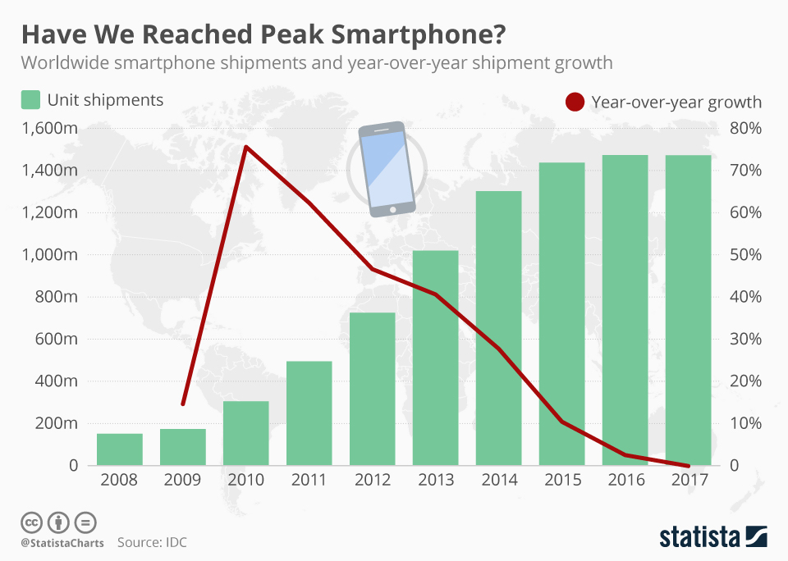
Some Bold Statements
the web owns B2B apps
we have reached peak smart phone
app fatigue is setting in
https://www.statista.com/chart/12798/global-smartphone-shipments/
Notes:
only to look at colleagues screens, not just techie
smart phone growth – click – not so bold
app fatigue? - reason for conversational interfaces (China WeeChat and Alibaba)
1 min (47)

Slide 24
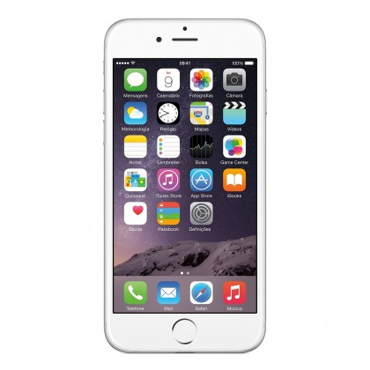
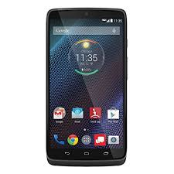



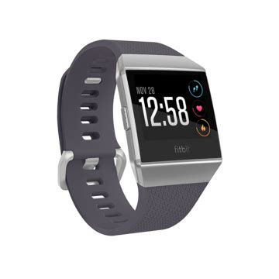
Notes:
smart phone growth but IoT and smart devices will grow and grow
language which patterns, libraries, practices for constrained, untrusted environments is already established
panasonic – js (samsung .net!)
nest – js, objectiveC, python
echo – js, c#, python, java
fitbit – js
(python strong showing)
2 mins (49)

Slide 25
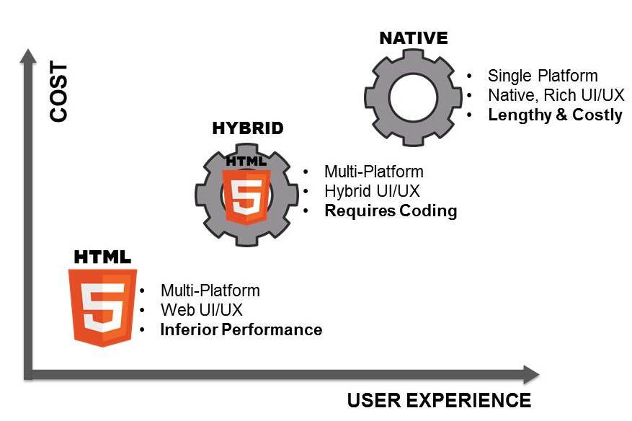
https://www.mobilesmith.com/html5-vs-native-debate-is-over/
Notes:
still 1.5 billion smartphones
switch to JS anytime soon?
slide demonstrates argument – url wrong!
1 min (50)

Slide 26
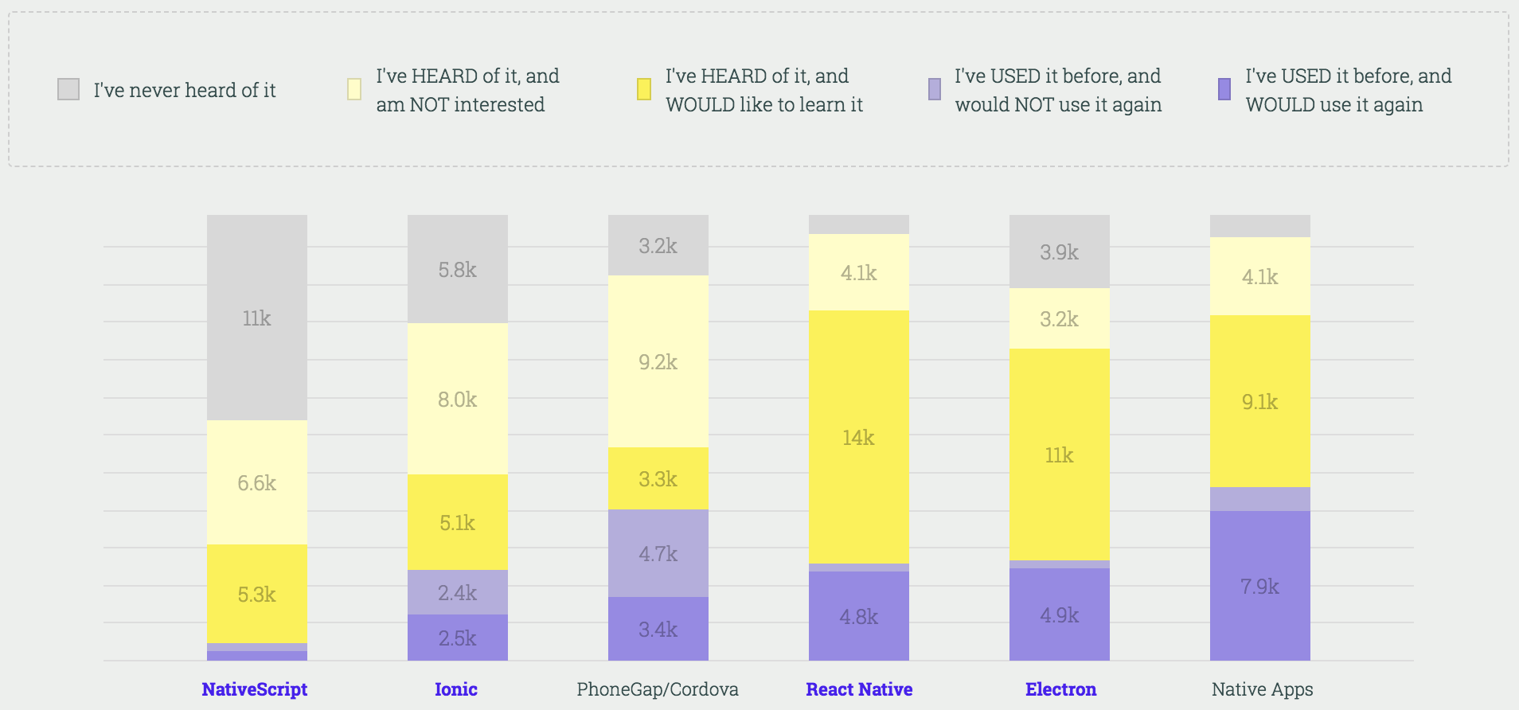
https://stateofjs.com/2017/mobile/results/
Notes:
slide supports that argument to a degree
but new approaches
common language/patterns/practices – React Native
message to my mobile colleagues – fine for now, but definitely keep coming to these talks :-p
2 mins (52)

Slide 27
Session 5 - Workshop
Monday 9th April 12:30
A Scary Walking Skeleton
Notes:
web 101 – build up web app from basics
in true agile style ‘walking skeleton’
in particular, how React changes things
follow along or do yourself
1 min (53)

Slide 28
Session 3
Monday 26th March 12:45
Javascript: its new natural habitat - everywhere
Notes:
Ode to Node
why changed so much
1 mins (54)

Slide 29
Thank You
https://www.surveymonkey.com/r/LPP5YV2

